Slide 1
UMD DATA605 - Big Data Systems Data Wrangling
GP Saggese
gsaggese@umd.edu
with thanks to Amol Deshpande

Slide 2
Overview
Goal: get data into a structured form suitable for analysis
Variously called: data preparation, data munging, data curation
Also often called ETL (Extract-Transform-Load) process
Often the step where majority of time (80-90%) is spent
Key steps:
Scraping: extracting information from sources, e.g., webpages, spreadsheets
Data transformation: to get it into the right structure
Data integration: combine information from multiple sources
Information extraction: extracting structured information from unstructured/text sources
Data cleaning: remove inconsistencies/errors

Slide 3
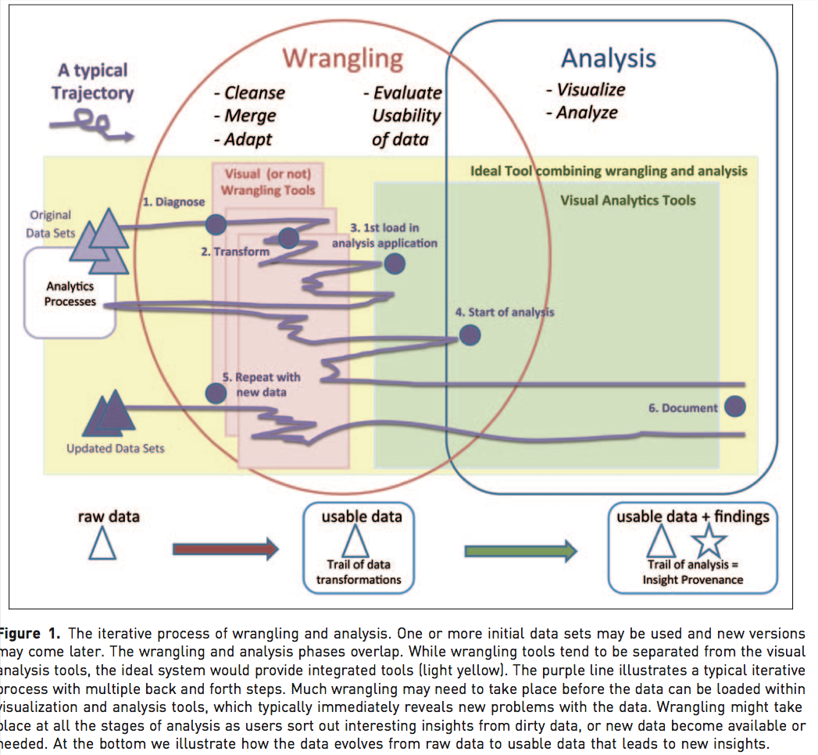
Overview

Slide 4
Overview
Many of the problems are not easy to formalize, and have seen little work
E.g., Cleaning
Others aspects of integration, e.g., schema mapping, have been studied in depth
Typical workflow
From Data Cleaning: Problems and Current Approaches
Somewhat old: data is mostly coming from structured sources
For a data scientist, the data scraping is equally important

Slide 5
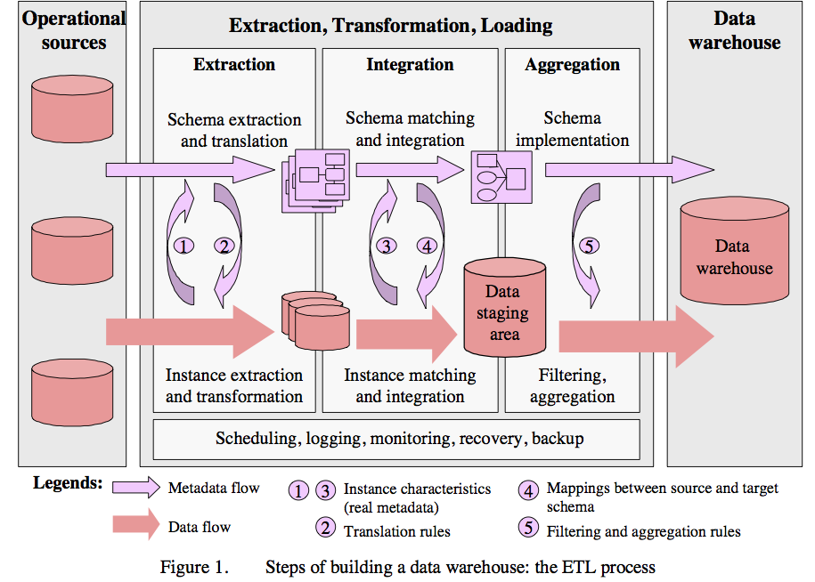
Overview

Slide 6
Single-Source Problems
Depends largely on the source
Databases can enforce constraints, whereas data extracted from files or spreadsheets, or scraped from webpages is much more messy
Types of problems:
Ill-formatted data, especially from webpages or files or spreadsheets
Missing or illegal values, Misspellings, Use of wrong fields, Extraction issues (not easy to separate out different fields)
Duplicated records, Contradicting Information, Referential Integrity Violations
Unclear default values (e.g., data entry software needs something)
Evolving schemas or classification schemes (for categorical attributes)
Outliers

Slide 7
Multi-source problems
Different sources are developed separately, and maintained by different people
Issue 1: Mapping information across sources (schema mapping/transformation)
Naming conflicts: same name used for different objects
Structural conflicts: different representations across sources
Issue 2: Entity Resolution: Matching entities across sources
Issue 3: Data quality issues
Contradicting information, Mismatched information, etc.

Slide 8
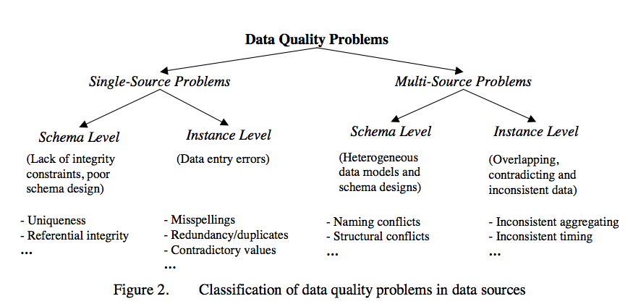
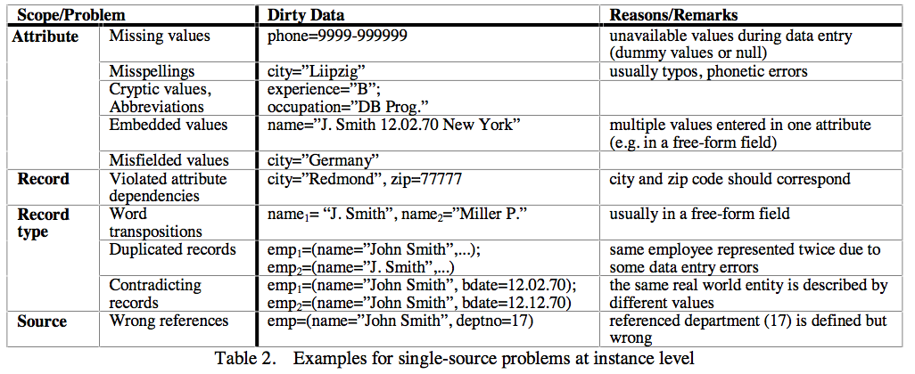
Data Quality

Slide 9
Data Scraping
Data may reside in a wide variety of different sources, including: CSV files, JSON files, XML, different databases, Spreadsheets, ...
Most analytical tools support importing data from such sources
Web scraping: Scraping data from web sources is tougher
In some cases, there may be APIs
In most other cases, data may have to be explicitly scraped
Often pipelines are set up to do this on a periodic basis
Can be fragile
Several tools out there to do this (somewhat) automatically
E.g., import.io, portia, ...

Slide 10
Data Cleaning: Outlier Detection
Mostly from: Quantitative Data Cleaning for Large Databases; by Hellerstein
Brief discussion of the general problem, but focuses primarily on quantitative data (i.e., integers/floats that measure some quantities of interest)
Sources of errors in data
Data Entry Errors: users putting in arbitrary values to satisfy the form especially problematic
Measurement Errors: Much data never sees human eyes, especially sensor data; however rife with all kinds of errors
Distillation Errors: errors that pop up during processing and summarization
Data Integration Errors: inconsistencies across sources that are combined together

Slide 11
Outlier Detection
Univariate outliers
A set of values can be characterized by metrics such as center (e.g., mean), dispersion (e.g., standard deviation), and skew
Can be used to identify outliers
Must watch out for "masking": one extreme outlier may alter the metrics sufficiently to mask other outliers
Should use robust statistics: considers effect of corrupted data values on distributions
Robust center metrics: median, k% trimmed mean (discard lowest and highest k% values)
Robust dispersion:
Median Absolute Deviation (MAD): median distance of all the values from the median value
A reasonable approach to find outliers: any data points 1.4826x MAD away from median
The above assumes that data follows a normal distribution
May need to eyeball the data (e.g., plot a histogram) to decide if this is true

Slide 12
Outlier Detection
Univariate outliers (cont.)
Wikipedia Article on Outliers lists several other normality-based tests for outliers
If data appears to be not normally distributed:
Distance-based methods: look for data points that do not have many neighbors
Density-based methods:
Define density to be average distance to k nearest neighbors
Relative density = density of node/average density of its neighbors
Use relative density to decide if a node is an outlier
Most of these techniques start breaking down as the dimensionality of the data increases
Curse of dimensionality
Can project data into lower-dimensional space and look for outliers there
Not as straightforward -- outlier detection

Slide 13
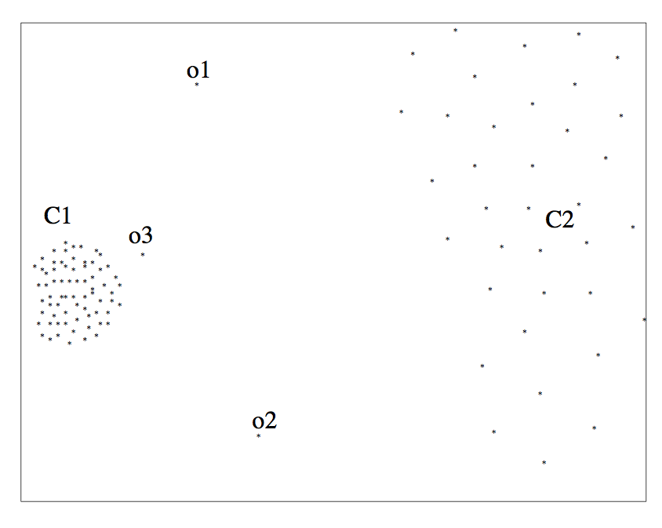
Univariate outliers example

Slide 14
Multivariate outliers
Analogous to univariate, one set of techniques based on assuming data follows a multi-variate normal distribution
Defined by a mean, μ, and a covariance matrix, Σ
Mahalanobis Depth of a point: Square root of (x - μ)'Σ⁻¹(x - μ)
Measures how far the point x is from the multivariate normal distribution
Look for points that are too far away
Mean/Covariance are not robust -- they are sensitive to outliers
Iterative approach: remove points with high Mahalanobis distance, recompute the mean and covariance
Several other general approaches discussed in the reference by Hellerstein
No clear guidelines here -- need to try different techniques based on the data

Slide 15
Time series outliers
Often the data is in the form of a time series
Can use the historical values/patterns in the data to flag outliers
Rich literature on forecasting in time series data

Slide 16
Frequency-based outliers
An item is considered a "heavy hitter" if it is much more frequent than other items
In relational tables, can be found using a simple groupby-count
Often the volume of data may be too much (e.g., internet routers)
Approximation techniques often used

Slide 17
Outliers
Things generally not as straightforward with other types of data
Outlier detection continues to be a major research area

